Slide 1
Software Development 3
Interfaces – Part 4

Slide 2
Interface Comparable
An interface is a way to describe what classes should do, without specifying how they should do it. It’s not a class but a set of requirements for classes that want to conform to the interface
E.g. public interface Comparable
{
int compareTo(Object otherObject);
}
this requires that any class implementing the Comparable interface contains a compareTo method, and this method must take an Object parameter and return an integer

Slide 3
The Comparable Interface
Comparable is an interface
Defined in the Java API
Contains only one method
compareTo(SomeObject o2)
There are functions in the Java API you can use to do useful things if your objects implement this interface.

Slide 4
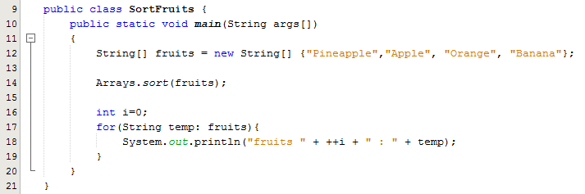
Example 1 – Sorting an Array
Line 14: sort is a static method that sorts the specified array into ascending order. Available in the package java.utils
Sample Output:
fruits 1 : Apple
fruits 2 : Banana
fruits 3 : Orange
fruits 4 : Pineapple

Slide 5
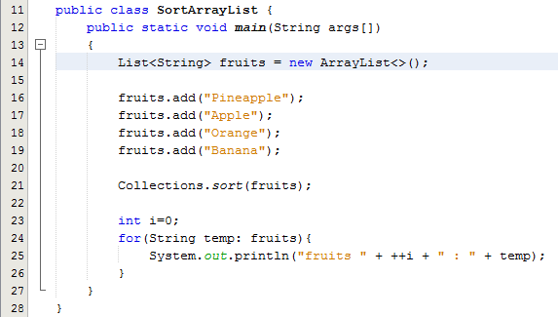
Example 2 – Sorting an ArrayList
Line 21: Collections.sort also works on array lists
Sample Output:
fruits 1 : Apple
fruits 2 : Banana
fruits 3 : Orange
fruits 4 : Pineapple

Slide 6
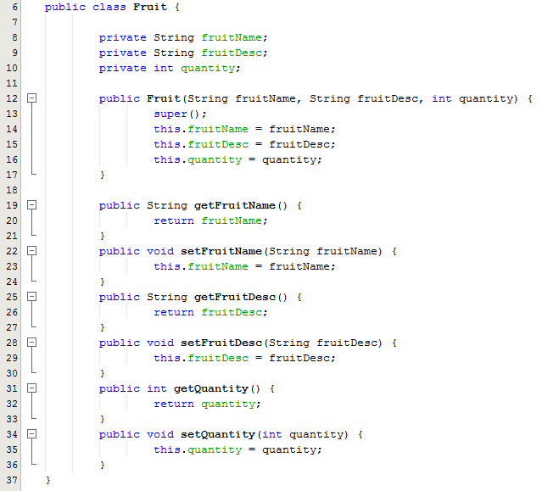
Example 3 – Sorting a collection of Objects: Step 1 Define a Fruit class

Slide 7
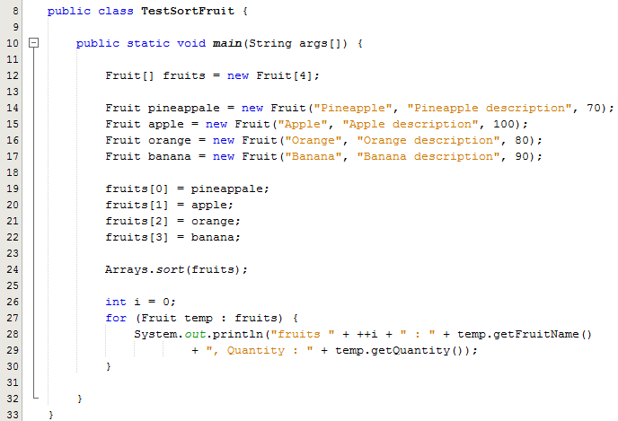
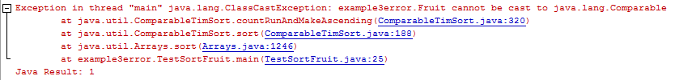
Example 3 – Sorting a collection of Objects: Step 2 Write the test class
To sort the array of Fruit objects we try the Arrays.sort() again – line 24
Because we didn’t specify what to sort in the Fruit class the program gives the error shown below

Slide 8
The Comparable Interface
To sort an Object by its property, you have to make the Object implement the Comparable interface and override the compareTo() method.
We need to amend the Fruit class to implement the Comparable interface and then override the compareTo() method

Slide 9
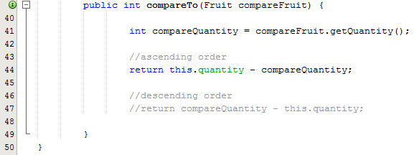
Example 3 – Changes to the Fruit class
The compareTo() method is hard to explain, in integer sorting, just remember
this.quantity – compareQuantity is ascending order.
compareQuantity – this.quantity is descending order.
Sample Output:
fruits 1 : Pineapple, Quantity : 70
fruits 2 : Orange, Quantity : 80
fruits 3 : Banana, Quantity : 90
fruits 4 : Apple, Quantity : 100

Slide 10
Example 4 – Sorting the fruit on multiple properties
How about sorting with Fruit’s “fruitName” or “Quantity”?
The Comparable interface is only allowed to sort a single property.
To sort with multiple properties, you need to use Comparator.

Slide 11
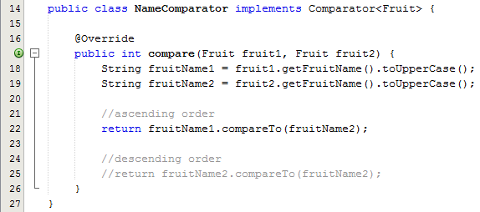
Example 4 – NameComparator Class
The class implements Comparator
Overrides the compare method
compareTo method used for String comparison
Sample Output:
fruits 1 : Apple, Quantity : 100
fruits 2 : Banana, Quantity : 90
fruits 3 : Orange, Quantity : 80
fruits 4 : Pineapple, Quantity : 70

Slide 12
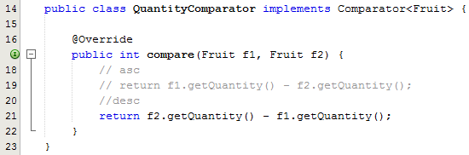
Example 4 – QuantityComparator Class
The class implements Comparator
Overrides the compare method
f1.getQuantity – f2.getQuantity is ascending order.
f2.getQuantity – f1.getQuantity is descending order.
Sample Output:
fruits 1 : Apple, Quantity : 100
fruits 2 : Banana, Quantity : 90
fruits 3 : Orange, Quantity : 80
fruits 4 : Pineapple, Quantity : 70

Slide 13
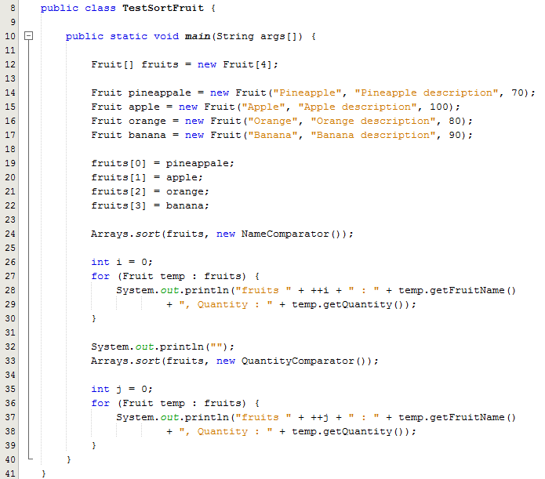
Example 4 – Test class
Line 24: Sorts the array of Fruit objects by name
Line 33: Sorts the array of Fruit objects by quantity

Slide 14
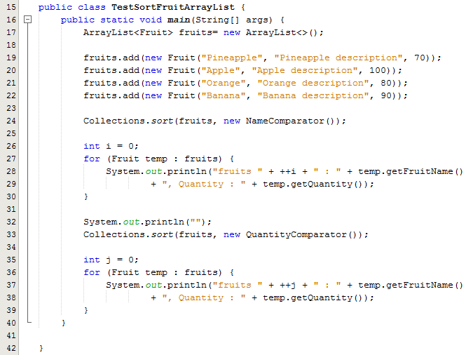
Example 4 – Test class
If we want to use an ArrayList instead of an array to store the object references, we need to use a different sort method
Line 24: Sorts the array of Fruit objects by name using Collections.sort method
Line 33: Sorts the array of Fruit objects by quantity
using Collections.sort method

